Slide 1
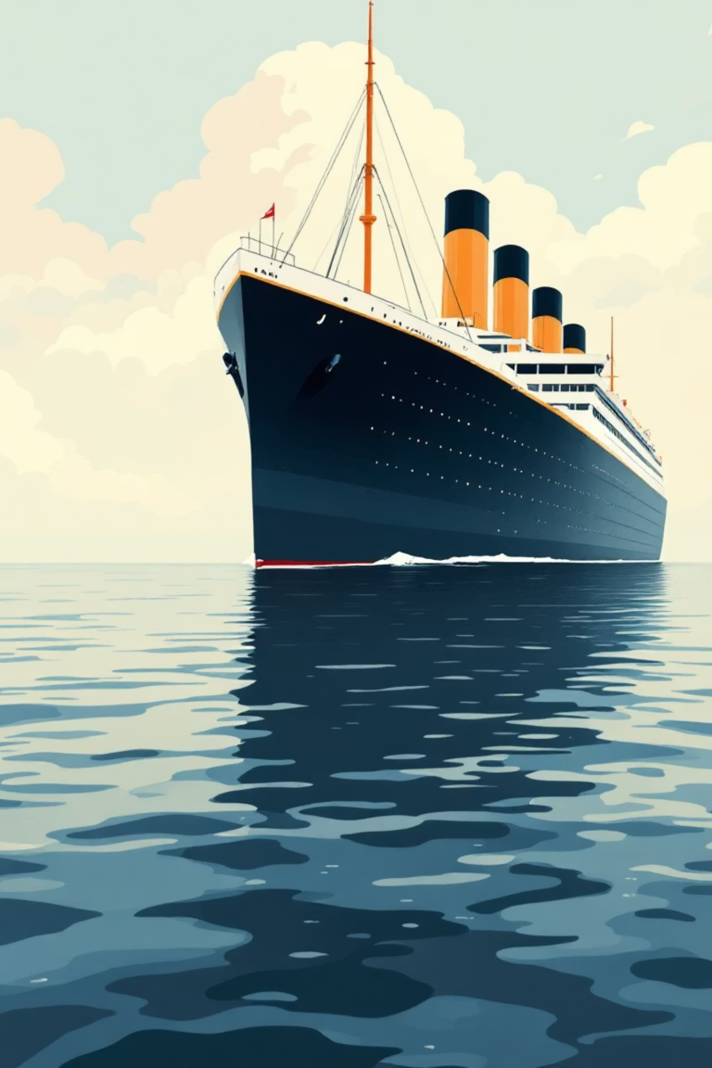
Titanic Survival Analysis and Prediction Model
Machine Learning Insights from the 1912 tragedy
Multiple ML Models compared
83.2% Accuracy
Interactive Dashboard
Portfolio Project | Data Science | Machine Learning

Slide 2

From Raw Data to Real Insights
The data challenge
891 passengers with real demographic information.
Missing values in Age ( 20% ) and cabin ( 77% ).
Historical dataset requiring careful interpretation.
My approach
Build a predictive model to understand survival determinants.
Uncover human stories through statistical analysis.
Create an interactive dashboard for exploration.

Slide 3

Complete Solution: An Interactive ML Dashboard
Data Wrangling & Cleaning
Model Development
Missing value imputation (Median Age).
Six ML Models trained and compared.
Feature engineering (Family-Size, Is-Alone).
Logistic Regression achieved 83.2% accuracy.
Categorical encoding for ML compatibility.
Hyperparameter tuning performed.
Interactive Dashboard
Exploratory Analysis
Streamlit-based visualisation platform.
Survival rate visualisation by class/gender.
Rule-based survival probability calculator.
Correlation analysis of key factors.
Demographic pattern exploration.
Historical pattern validation.
User-friendly data interface.

Slide 4

Primary Survival Factors Discovered
Strongest Predictors
Model Feature Importance
Gender: 74% female vs. 19% male survival.
Gender and Class were top predictors.
Passenger Class: Wealth = Survival advantage.
FamilySize engineering improved accuracy.
Age: Children prioritized in rescue.
Gender analysis showed predictive power.
Fare: Proxy for wealth and location.
Logistic Regression: 83.2% Model Accuracy
Random Forest: 79.3% Accuracy
Validated through cross-validation

Slide 5
Technical Implementation
Two - component architecture
ML Model Pipeline:
Raw Titanic Data → Cleaning → Feature Engineering → Model Training → 83.2% Accuracy
Dashboard Pipeline:
Raw Titanic Data → Visualisation → Rule-based logic → Interactive Interface
Machine Learning Stack
Scikit-learn: 6 ML Models ( Logistic Regression, Random Forest, etc. ).
Pandas/NumPy: Data manipulation.
Seaborn/Matplotlib: Visualization.
Streamlit: Interactive dashboard.
Model Performance
Accuracy: 83.2%.
Feature importance analysis.
5-fold Cross-validation.
Model comparison visualisation.

Slide 6





Model Performance & Insights
Key Metrics
Data-Driven Discoveries
Confirmed Historical Patterns
✔ "Women and children first" protocol validated by data.
83.2%
✔ Class privilege dramatically affected survival chances.
✔ Wealth (via Fare) correlated with better outcomes.
Accuracy
Unexpected Insights
• Family size sweet spot (1-3 members optimal).
• Passenger titles stronger predictors than raw age.
• Complex interactions between features.
80%
Visualization Highlights
• Survival comparison charts by class and gender.
• Age distribution comparisons.
Precision
• Fare vs. survival correlation plots.
75.4%
Recall
77.6%
F1-Score

Slide 7

Model Comparison Results
BEST MODEL: Logistic Regression
OTHER MODELS:
Accuracy: 83.2%
Random Forest: 79.3% Accuracy
Precision: 80.0%
Gradient Boosting: 81.6% Accuracy
SVM: 83.2% Accuracy
Recall: 75.4%
F1-Score: 77.6%
Key Finding: Logistic Regression outperformed ensemble methods on this dataset.

Slide 8

Impact & Future Development
Current Achievement
✅ Production ML model with 83.2% accuracy.
✅ Interactive dashboard for data exploration.
✅ Comprehensive analysis of survival factors.
✅ Educational resource for ML learners.
Key Learnings
Feature engineering transforms model performance.
Historical data requires contextual interpretation.
Visualization bridges technical and non-technical audiences.
Future Enhancements
Ensemble methods (XGBoost, Gradient Boosting).
Neural network implementation.
Passenger story integration with data points.
API deployment for broader access.
The Titanic's data continues to teach us about survival, bias, and human decision-making.
Project by: [Rudzani Junior Munyai] | GitHub: [https://​github.com/24Rudzani​]

